Slide 1
Virtual voting machine

Slide 2
AGENDA
Introduction​
Technology used
​Features
​Architecture​
EVM vs VVM

Slide 3
Introduction
In this project, we are building an online voting mechanism which will allow people to cast their vote online from anywhere. Vote casting will be decentralized and transparent. One person will be allowed to give only one vote after verifying their identity.
For developing E-voting machine using blockchain we used Ethereum – a popular platform for creating distributed blockchain application that support smart contract.

Slide 4
Features
People will be able to vote anywhere, anytime.
Faster and decentralised.
Casting of votes will be fully transparent.
Votes are immutable.
Anonymity
Singularity and Vote Privacy

Slide 5
Technology used
Solidity : Smart Contracts
React.js : Frontend
Node.js : Backend
Metamask : Crypto Wallet

Slide 6
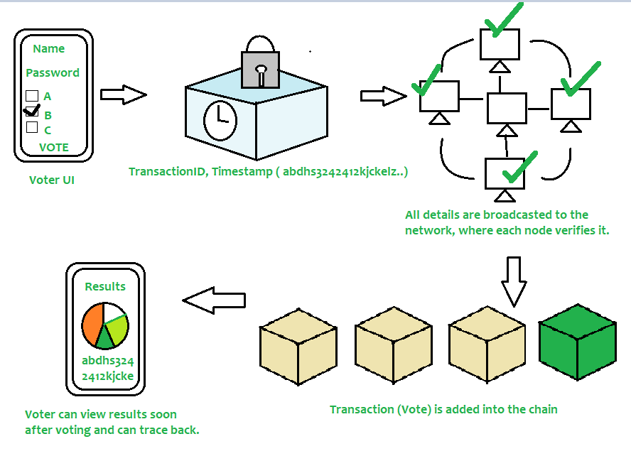
Architecture of vvm

Slide 7
Blockchain eV vs Traditional EV

Slide 8
How Blockchain can transform the electronic voting system?
Shortcomings fixed: clear & accessible, stopped illegal voting, strengthen the data protection, checked the outcome of polling.
Electronic voting carries significant risks, if compromised, all cast votes can probably be manipulated and misused.
A viable solution to overcome the risks and electronic voting, which is blockchain technology.
In traditional voting systems, we have a central authority to cast a vote.
If someone wants to modify or change the record, they can do it quickly; no one knows how to verify that record.
One does not have the central authority; the data are stored in multiple nodes.
It is not possible to hack all nodes and change the data.

Slide 9
THANK YOU
Supervised by: Ms. Akankasha
Members -
Utkarsh Mishra
Surya Pratap Singh
Adrika Tripathi

